Slide 1
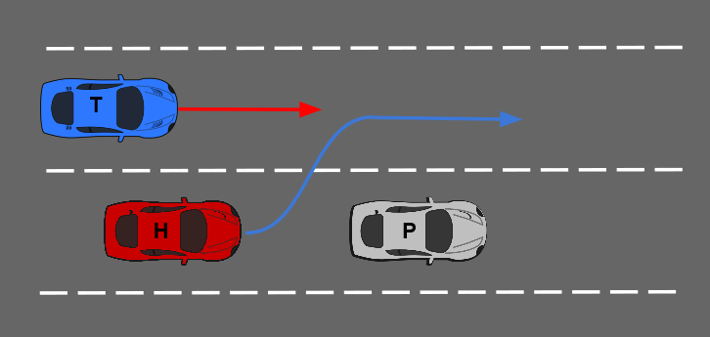
Optimal Overtaking for Autonomous Vehicles
Purpose
Cars often find themselves behind slower moving vehicles such as trucks on the highway. In these situations, they must make the decision to either overtake or trail the leading vehicle, weighing both decisions to make a safe, yet optimal manoeuvre.
Method
An optimal path for the overtaking manoeuvre is developed in previous work.
On similar lines, an MPC problem over a fixed space horizon is solved to yield an optimal trailing manoeuvre.
To overtake or not to overtake
At each instant, the overtaking and following manoeuvres are evaluated against each other
This is done using an objective function that compares the kinematics of the manoeuvres, the deviation from the reference speed and the decision robustness.
Evaluation
Scenario 1 - Leading vehicle with deceleration -
The host follows a vehicle that slows down making an overtake necessary
Notes:
<number>

